Slide 1

The PROGRESSIVE CURRICULUM FRAMEWORKS & Capacity Matrices: a companion to both the
Australian curriculum & aUSvels
Excellence in Professional Practice Conference
Improving assessments of student learning
21-23 May 2015
Novotel, Brighton Beach, Sydney
http://www.pinterest.com/effectivecurric/
https://www.facebook.com/effectivecurriculumideas1
Foundation to Years 7/8
Facilitator: Mr Anton Reiter
(BTeach, BBM, CIVIT)
Primary School Teacher and
Educational Consultant: Effective Curriculum Ideas
http://www.linkedin.com/in/effectivecurriculumideas
http://twitter.com/EffectiveCurric

Slide 2
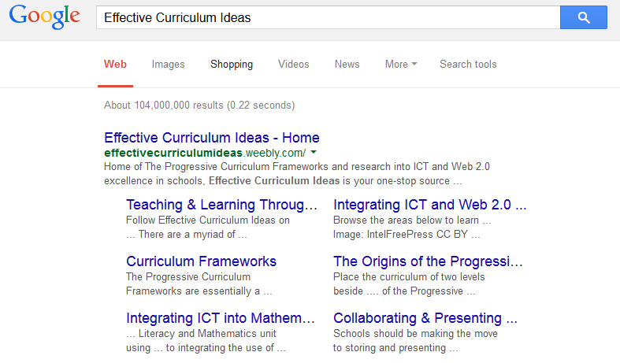

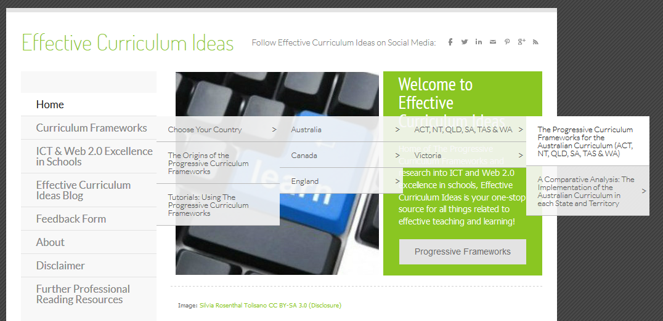

All of the following documents are free and can be found on the website →
Excellence in Professional Practice Conference
Improving assessments of student learning
21-23 May 2015
Novotel, Brighton Beach, Sydney

Slide 3
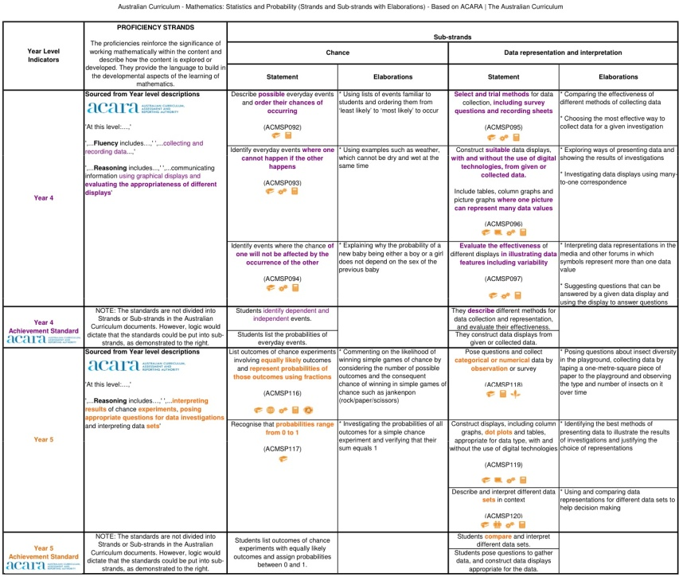
All images throughout the presentation can be clicked on/selected to open online versions of the files:
Excellence in Professional Practice Conference
Improving assessments of student learning
21-23 May 2015
Novotel, Brighton Beach, Sydney

Slide 4
Curriculum….
Excellence in Professional Practice Conference
Improving assessments of student learning
21-23 May 2015
Novotel, Brighton Beach, Sydney
Differs from country to country (or even state to state)
Is in black and white
Contains chunky paragraphs
Can be hard to understand
Is aimed at: Teachers? Parents? Students?
Changes often
Can scare teachers from continuing or recommencing their teaching careers (e.g. maternity leave).

Slide 5
Curriculum….
Excellence in Professional Practice Conference
Improving assessments of student learning
21-23 May 2015
Novotel, Brighton Beach, Sydney
But it doesn’t have to be like that...

Slide 6
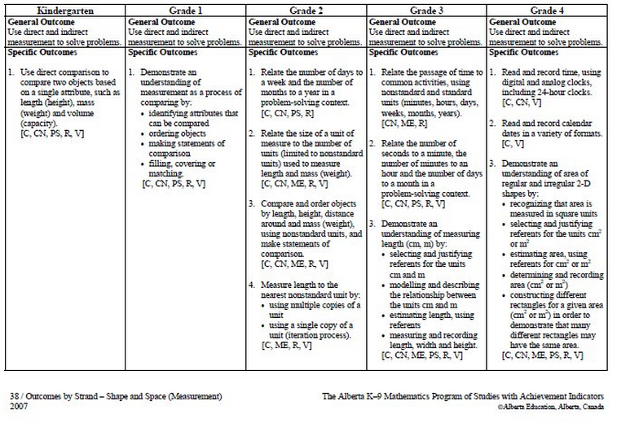
Curriculum….
Excellence in Professional Practice Conference
Improving assessments of student learning
21-23 May 2015
Novotel, Brighton Beach, Sydney
Various provinces in Canada release already their curricula in tables, however, not all related statements align.

Slide 7
Curriculum IS MEANT TO:
Excellence in Professional Practice Conference
Improving assessments of student learning
21-23 May 2015
Novotel, Brighton Beach, Sydney
Guide all those involved in education to know what needs to be known to help everyone achieve their potential
Be easy to understand for all stakeholders.
This is where The Progressive Curriculum Frameworks
fill a gap.

Slide 8
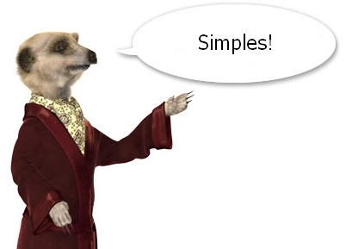

PCF Introduction:
Excellence in Professional Practice Conference
Improving assessments of student learning
21-23 May 2015
Novotel, Brighton Beach, Sydney
The PCF are a replica of the current curriculum (ACARA & VCAA) documents:
NOT A WORD HAS CHANGED (although ACARA did permit the use of capital letters at the start of each elaboration)
It’s been put into a table
Colour and bolded text denotes progression
Each grade/level has its own colour!
The documents below comply with the ACARA Copyright Guidelines - see the disclaimer here.

Slide 9
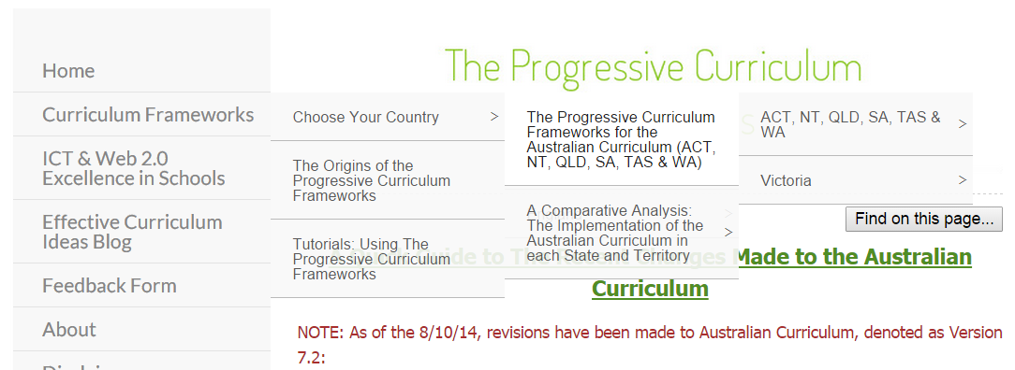
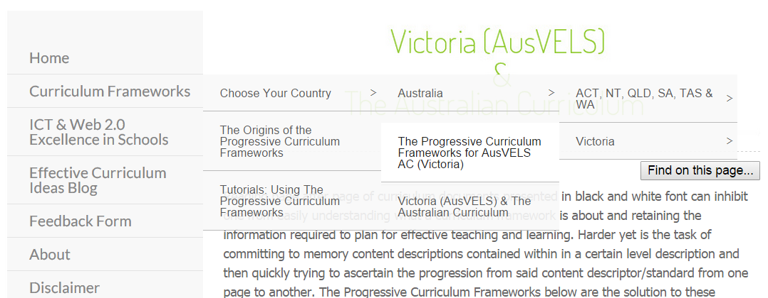
PCF Introduction (Online):
Excellence in Professional Practice Conference
Improving assessments of student learning
21-23 May 2015
Novotel, Brighton Beach, Sydney
Australian Curriculum:
AusVELS:

Slide 10
PCF Introduction:
Excellence in Professional Practice Conference
Improving assessments of student learning
21-23 May 2015
Novotel, Brighton Beach, Sydney
They are also available for parts of Canada and
England.

Slide 11
PCF Introduction:
Excellence in Professional Practice Conference
Improving assessments of student learning
21-23 May 2015
Novotel, Brighton Beach, Sydney
They are:
Downloadable in PDF (but PDF files do not allow users to copy formatted (e.g. bold and colour) text.
Available in Excel (but most educators would have a need for those files)
Available in unmerged Excel format (ideal for those who wish to copy and paste the content into planners).

Slide 12
PCF Introduction: MATHS
Excellence in Professional Practice Conference
Improving assessments of student learning
21-23 May 2015
Novotel, Brighton Beach, Sydney
Open PDFs:
AC Maths PCF: Number & Algebra (Online)
AusVELS Maths PCF: Number & Algebra (Online)
Open Excel (Originals):
AC Maths PCF: Number & Algebra (Online)
AusVELS Maths PCF: Number & Algebra (Online)
Open Excel (Unmerged – for copying and pasting):
AC Maths PCF (Online)
AusVELS Maths PCF (Online)

Slide 13
PCF Introduction: ENGLISH
Excellence in Professional Practice Conference
Improving assessments of student learning
21-23 May 2015
Novotel, Brighton Beach, Sydney
Open PDFs:
AC English PCF (Online)
AusVELS English – Writing PCF (Online) & Scope & Sequence
Open Excel (Originals):
AC English PCF (Online)
AusVELS English PCF (Online)
Open Excel (Unmerged – for copying and pasting):
AC English PCF (Online)
AusVELS English PCF (Online)

Slide 14
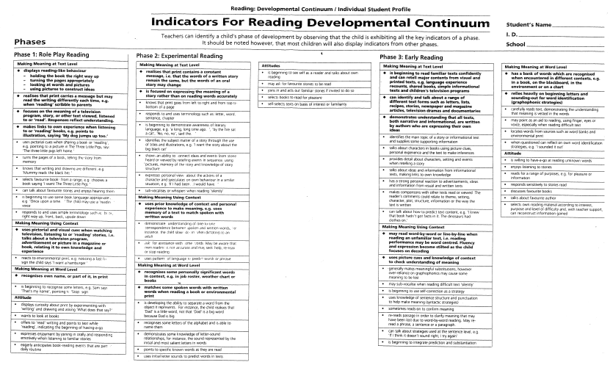
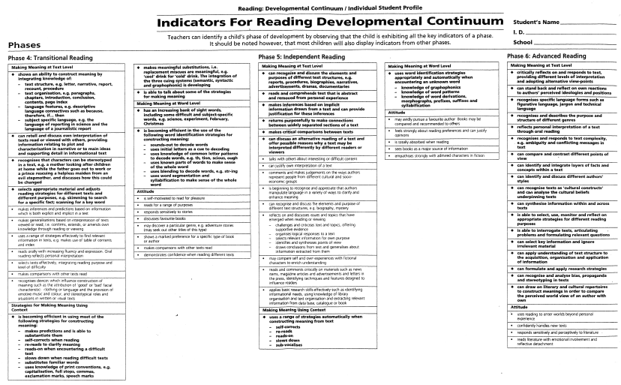
FIRST STEPS CONTINUUM….
Excellence in Professional Practice Conference
Improving assessments of student learning
21-23 May 2015
Novotel, Brighton Beach, Sydney
Even the First Steps Continuums are in black and white….
(Pre) K-3
Levels/Grades 4-7+

Slide 15
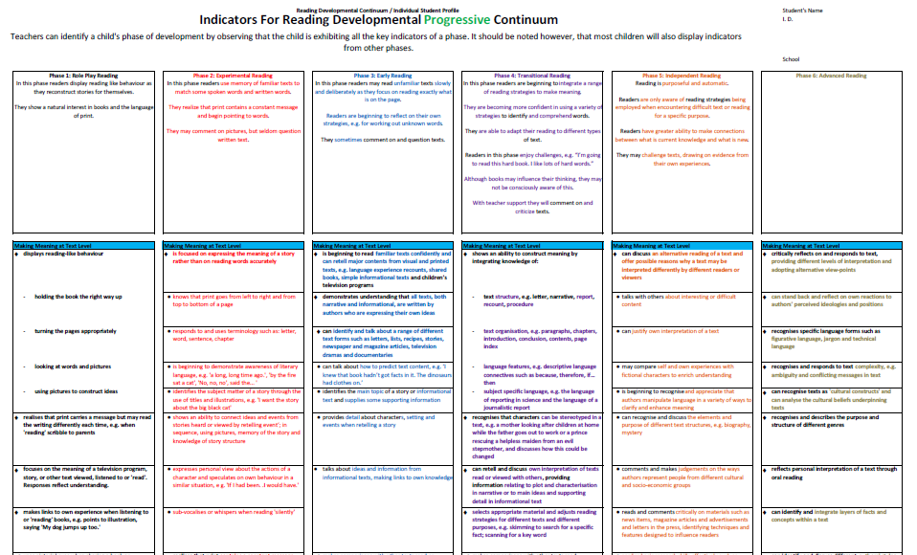
PROGRESSIVE FIRST STEPS CONTINUUM
(not yet available: pending copyright approval)
Excellence in Professional Practice Conference
Improving assessments of student learning
21-23 May 2015
Novotel, Brighton Beach, Sydney

Slide 16

Using the frameworks: tutorials
Excellence in Professional Practice Conference
Improving assessments of student learning
21-23 May 2015
Novotel, Brighton Beach, Sydney
Using The Frameworks: Tutorials

Slide 17
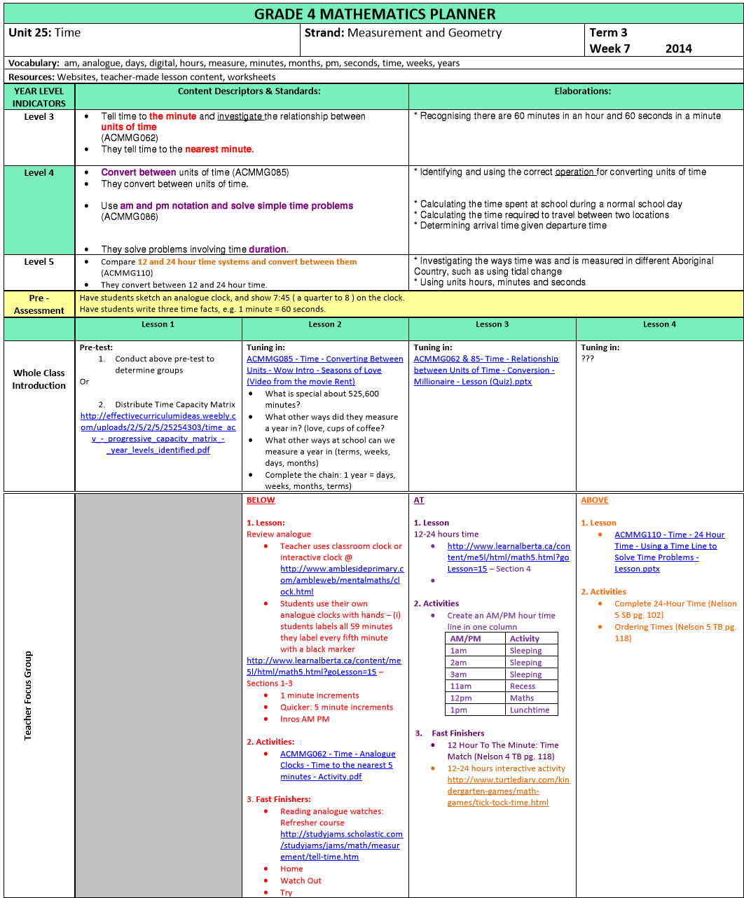
Using the frameworks: tutorials
Excellence in Professional Practice Conference
Improving assessments of student learning
21-23 May 2015
Novotel, Brighton Beach, Sydney
There are many applications for the PCFs
Differentiated planners (administrators love these)

Slide 18
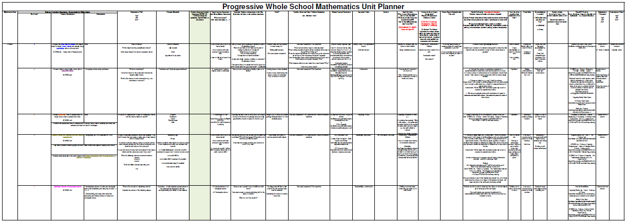
Using the frameworks: tutorials
Excellence in Professional Practice Conference
Improving assessments of student learning
21-23 May 2015
Novotel, Brighton Beach, Sydney
There are many applications for the PCFs
Whole school planning:

Slide 19
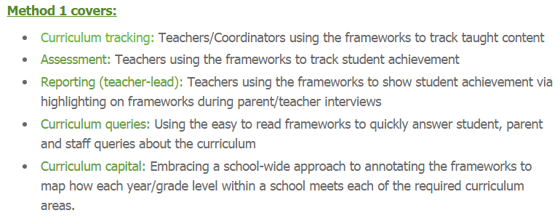
Using the frameworks: tutorials
Excellence in Professional Practice Conference
Improving assessments of student learning
21-23 May 2015
Novotel, Brighton Beach, Sydney
There are many applications for the PCFs

Slide 20
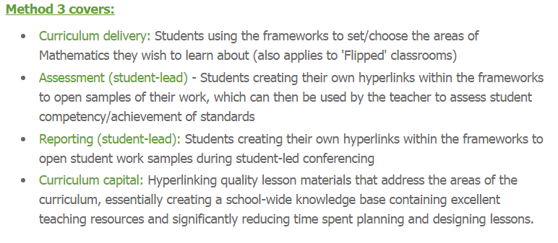
Using the frameworks: tutorials
Excellence in Professional Practice Conference
Improving assessments of student learning
21-23 May 2015
Novotel, Brighton Beach, Sydney
There are many applications for the PCFs
**
**
**
** Denotes applicable to this conference's foci: assessment and reporting

Slide 21
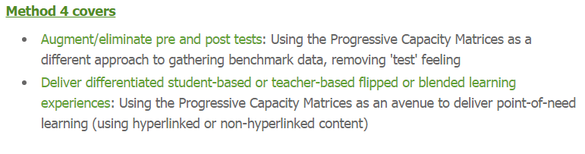
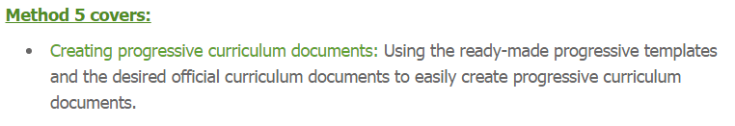
Using the frameworks: tutorials
Excellence in Professional Practice Conference
Improving assessments of student learning
21-23 May 2015
Novotel, Brighton Beach, Sydney
There are many applications for the PCFs
**
**
**

Slide 22
abstract
Excellence in Professional Practice Conference
Improving assessments of student learning
21-23 May 2015
Novotel, Brighton Beach, Sydney
Sometimes:
students present with Mathematics knowledge and skills that are not reflective of those listed on their previous reports
new students arrive into the classroom without available and actionable data
students find any testing of their skills (to determine a baseline) to be a traumatic experience.
Students should also be able to access a completely differentiated learning experience at all times.
To address these issues, the Progressive Curriculum Frameworks were combined with Quality Learning Australia’s (QLA) Capacity Matrix.

Slide 23
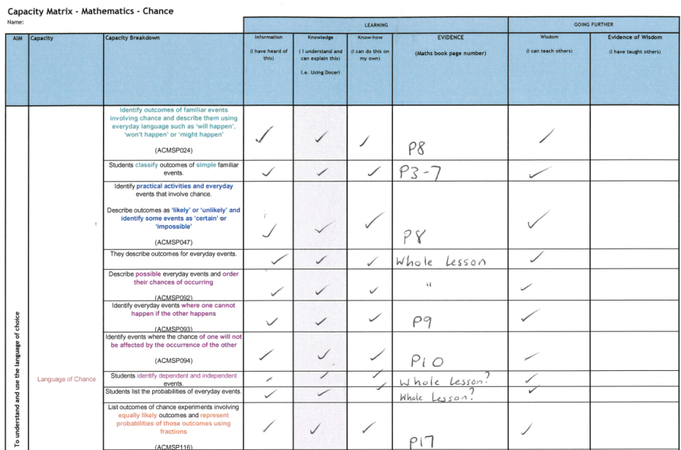
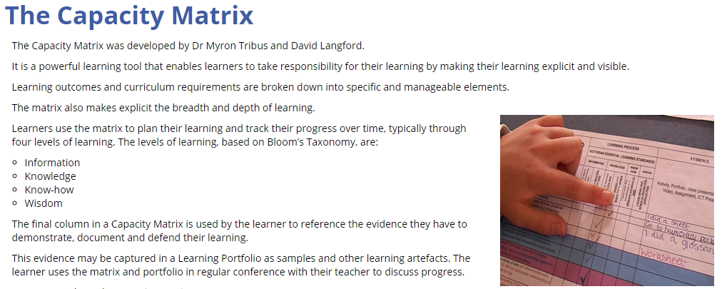
BackGROUND:
Excellence in Professional Practice Conference
Improving assessments of student learning
21-23 May 2015
Novotel, Brighton Beach, Sydney
© QLA
QLA have given their permission for the use, upload and dissemination of the Progressive Capacity Matrices to the Effective Curriculum Ideas website. They are free to use and modify.

Slide 24
The progressive capacity matrices
Excellence in Professional Practice Conference
Improving assessments of student learning
21-23 May 2015
Novotel, Brighton Beach, Sydney
AC: Online
AusVELS: Online

Slide 25
The progressive capacity matrices
Excellence in Professional Practice Conference
Improving assessments of student learning
21-23 May 2015
Novotel, Brighton Beach, Sydney
Teacher-Designed vs Student-Directed Learning
Student-directed learning: Teachers can modify the working to meet student needs or students can learn how to interpret the capacity (content descriptor, elaboration or standard) and find their own way to learn (e.g. using Khan Academy or Blendspace).
Teacher-designed learning: Teachers can create or set tasks, both digitally (e.g. hyperlinked to online work) or non-digitally.

Slide 26
The progressive capacity matrices
Excellence in Professional Practice Conference
Improving assessments of student learning
21-23 May 2015
Novotel, Brighton Beach, Sydney
Students and teachers can use The Progressive Capacity Matrices throughout the learning process to help them track their growth and learning or as an end of unit task (see video at 2:01) to find and state evidence that they have met the applicable standards, content descriptors and elaborations. Students also have the opportunity to identify when they have taught someone (higher learning) and to identify avenues for filming student tutorials for their Interactive ePortfolios.

Slide 27
The progressive capacity matrices
Excellence in Professional Practice Conference
Improving assessments of student learning
21-23 May 2015
Novotel, Brighton Beach, Sydney
There are a variety of formats:
Year levels not stated (but known to teachers and parents via the use of colours)

Slide 28
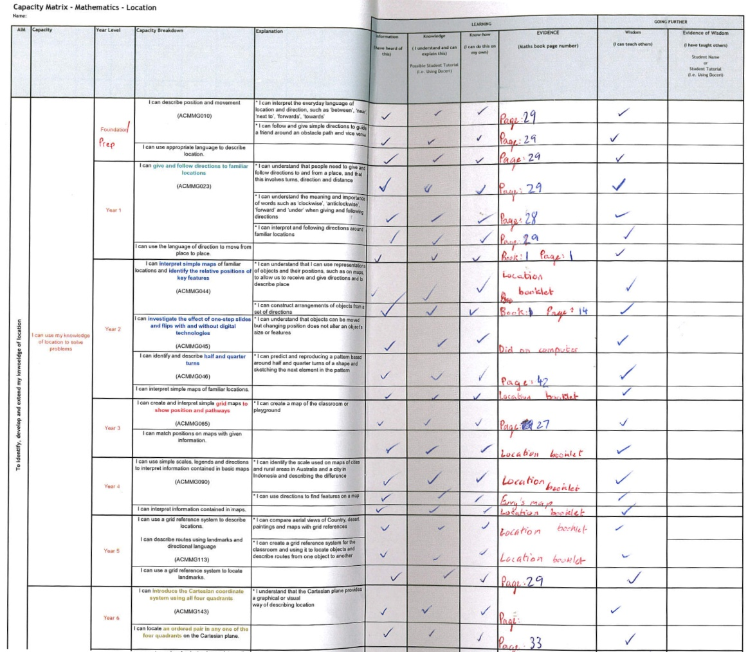
The progressive capacity matrices
Excellence in Professional Practice Conference
Improving assessments of student learning
21-23 May 2015
Novotel, Brighton Beach, Sydney
There are a variety of formats:
Include year level labelling, remove curriculum jargon, state progression in plain form using the leading statement of, "I can".

Slide 29
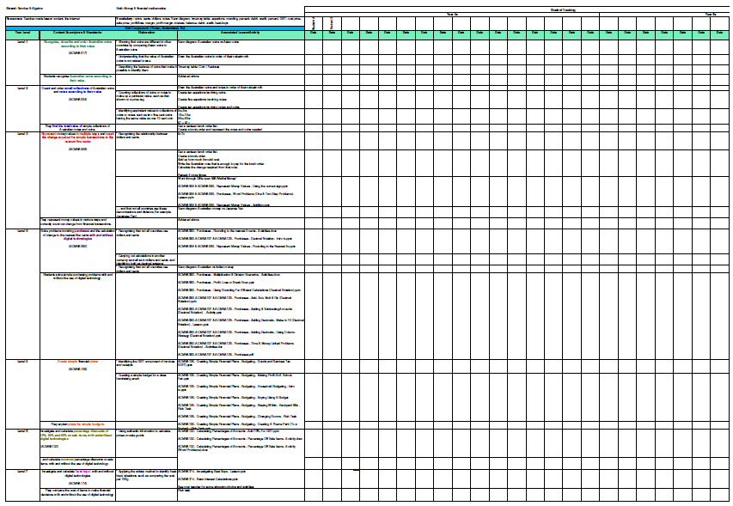
The progressive capacity matrices
Excellence in Professional Practice Conference
Improving assessments of student learning
21-23 May 2015
Novotel, Brighton Beach, Sydney
Teachers and students can keep a master record of tracking via a unit planner.

Slide 30
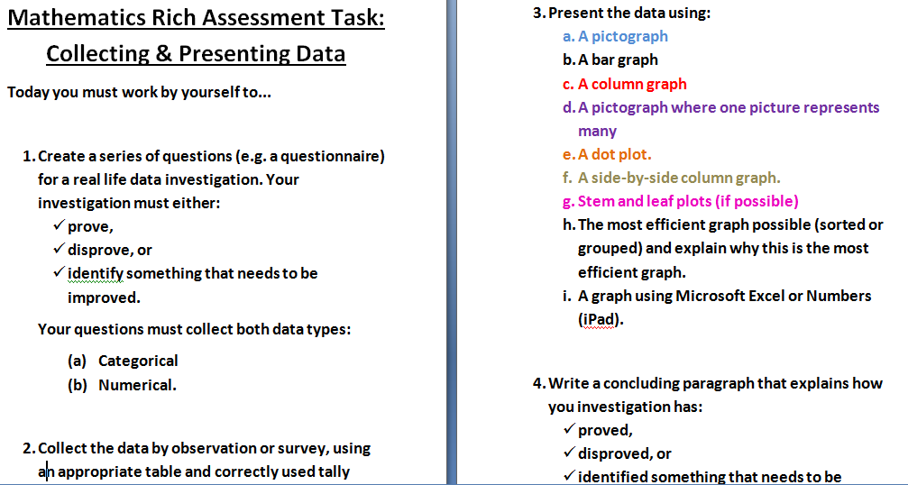
The progressive capacity matrices
Excellence in Professional Practice Conference
Improving assessments of student learning
21-23 May 2015
Novotel, Brighton Beach, Sydney
Summative assessments can also be linked the Progressive Capacity Matrices.

Slide 31
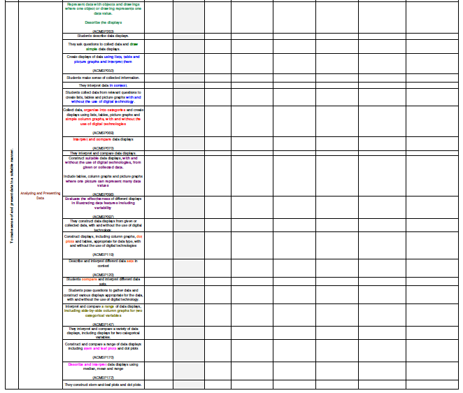
The progressive capacity matrices
Excellence in Professional Practice Conference
Improving assessments of student learning
21-23 May 2015
Novotel, Brighton Beach, Sydney
Summative assessments can also be linked the Progressive Capacity Matrices.

Slide 32
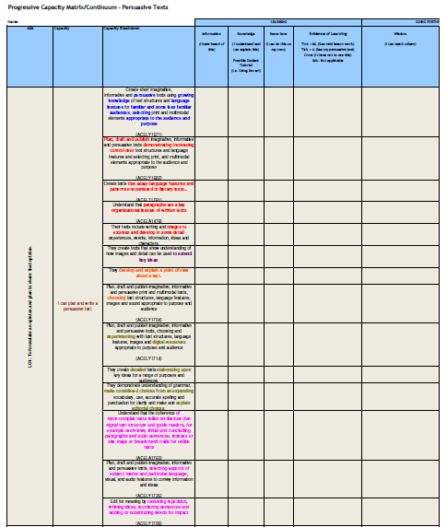
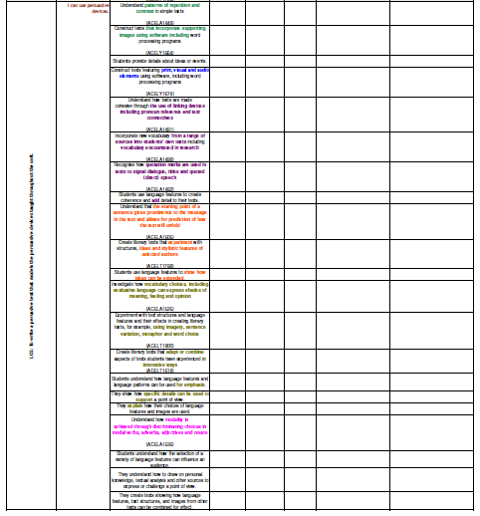
Capacity matrices and progressive capacity matrices can be used across all disciplines

Slide 33
The progressive capacity matrices
Excellence in Professional Practice Conference
Improving assessments of student learning
21-23 May 2015
Novotel, Brighton Beach, Sydney
The PCFs and PCMs can be linked to digital content:
Access network files via FileExplorer (iOS) or ESFileExplorer (Android)
Hyperlinking:
    Adobe Acrobat (Windows)
    MacOS PDF Editor (Mac)

