Slide 1

Using teacher designed online assessments
to drive differentiated instruction in mathematics
This presentation:
http://bit.ly/eppc2015
T: @anthsperanza
B: anthsperanza.global2.vic.edu.au
G: +AnthonySperanza
Anthony Speranza
St Mark’s Primary School Dingley, Victoria
ICT / T&L Leader
Debbie Darvell
St Mark’s Primary School,
Dingley, Victoria
Principal
Philip Holmes-Smith,
Director at School Research Evaluation and Measurement Services, Victoria

Slide 2

Setting The Scene
The mathematics data across the school varied from year to year - inconsistent - WHY?
Needed a F - 6 continuum & collective notion of how we were teaching and the links between levels
Focus on cohesion and alignment
Concept of growth not being challenged

Slide 3
In 2011 we began to train staff in data literacy.
Through analysing PATM and NAPLAN data, teachers began to see the value of being data literate
This precipitated need to engage in whole school professional development in the area of mathematics

Slide 4
Having observed the mathematics program...
The leadership & Maths leader examined the cohesion of the maths program across the school
Focussed on designing assessment that was used for pre & post assessment
Monitored student growth for each unit
Refined & aligned the units of work

Slide 5
Assessment in mathematics
Previous assessment schedule for mathematics was not revealing accurate and useful information about students
PLTs developed more rigorous use of pre and post assessments to inform teaching points
Senior year teachers began to explore the use of Google Forms to improve the efficiency and effectiveness of teaching and learning cycle in mathematics

Slide 6

Google Forms and formative assessment in maths
Teaching a differentiated unit of time

Slide 7
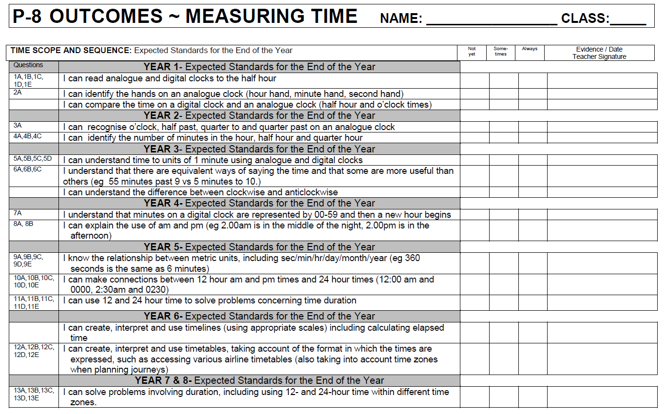
A P-8 Scope & Sequence of outcomes in student friendly language.

Slide 8
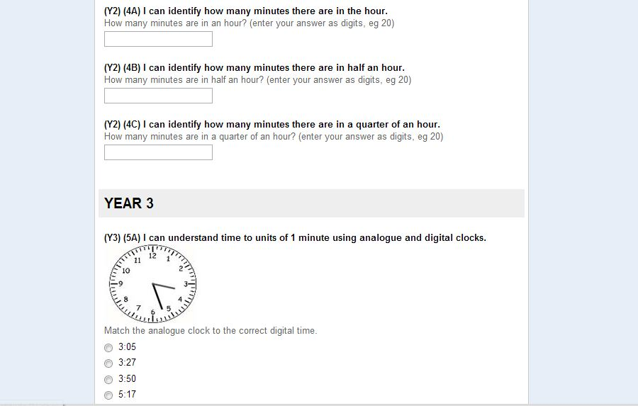
Designing a pre-assessment to determine student’s prior knowledge.

Slide 9

Link is shared, students complete the assessment.

Slide 10
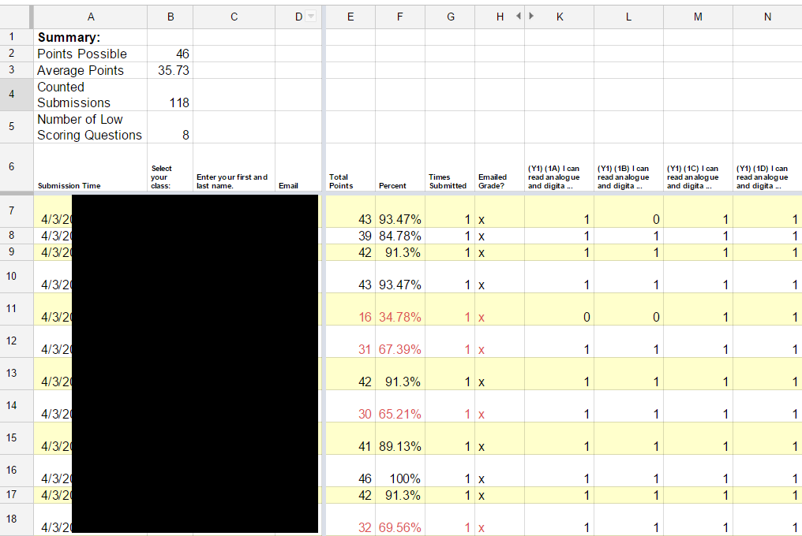
Results are collected and graded using Flubaroo.

Slide 11
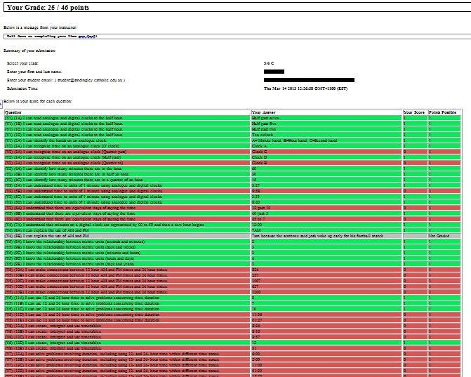
Students receive an email with their results.

Slide 12
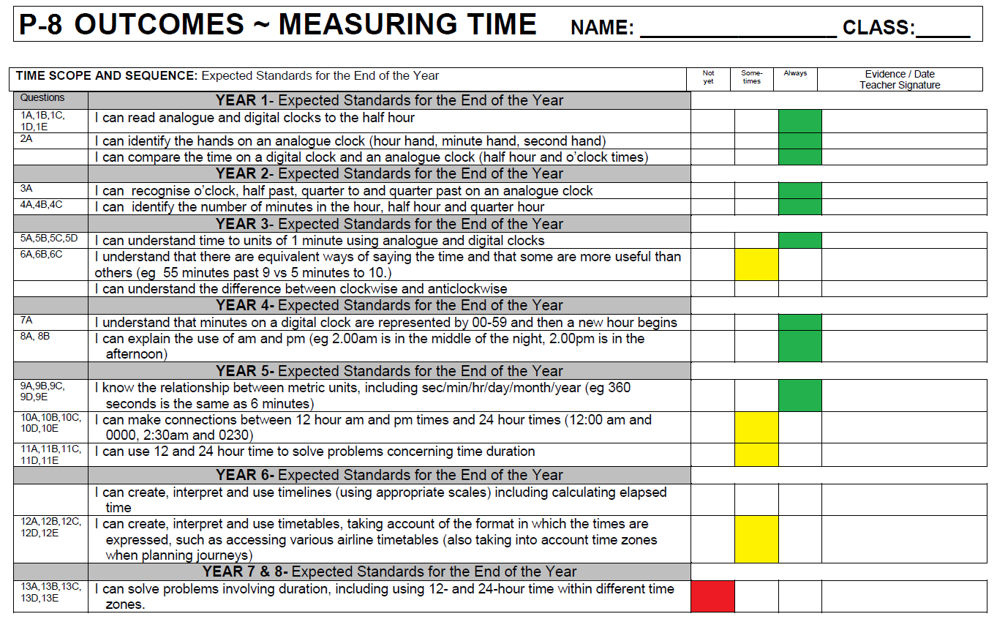
Students use their S&S to determine what they know.

Slide 13
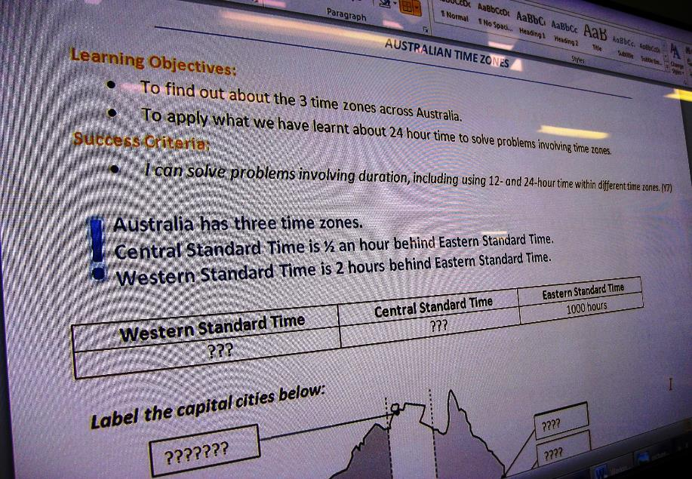
Students learn at their point of need over 6 explicit lessons.

Slide 14

Students take the same test as a post-assessment.

Slide 15
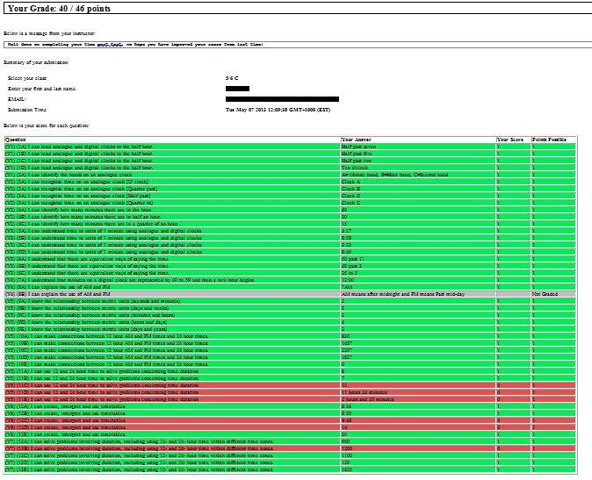
Students receive their results and track their growth.

Slide 16
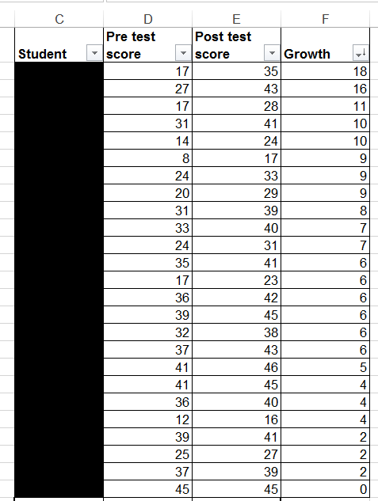
Pre & Post Assessment of learning has been collected

Slide 17
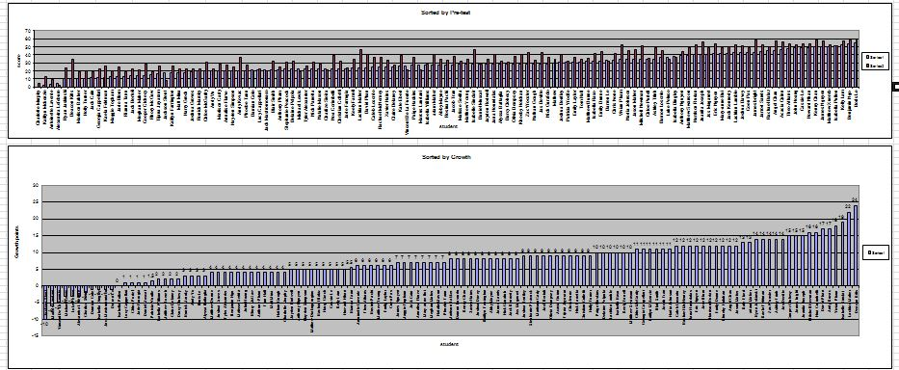
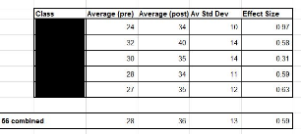
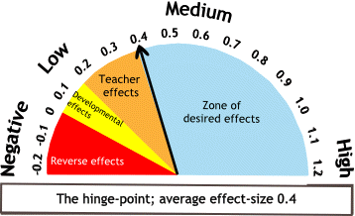
Evaluation and reflection of teaching & learning.
Effect size >0.59 (n=125)
Effect size of 0.86 once anomalies were removed (n=110)

Slide 18

Google Forms and formative assessment in maths.
Pre and Post data is automatically collected to ascertain effectiveness
Saved on paper and printing
Teachers are able to track students
Neither students nor teacher have to mark the test
Time saved means more time for learning
Immediate feedback is given
Students learn at their point of need

Slide 19
Assessment for, as and of learning.

Slide 20
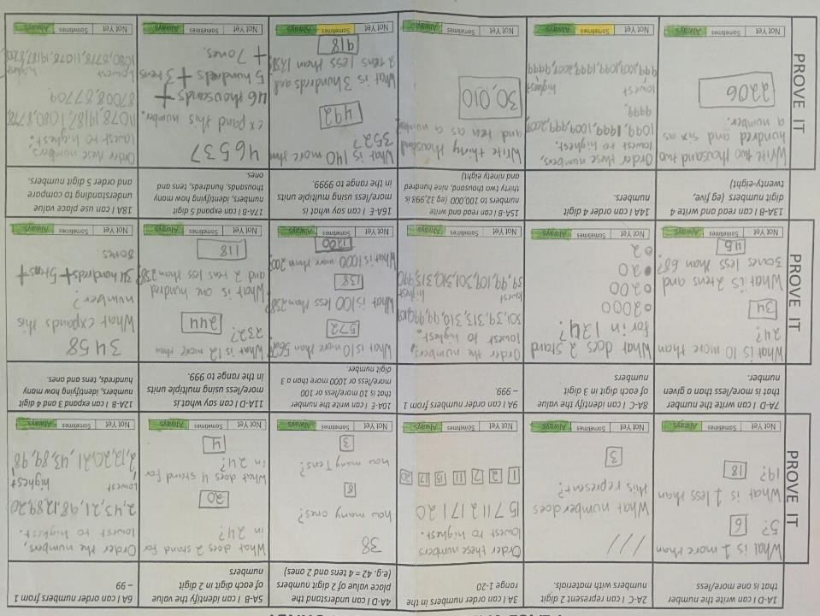

Slide 21
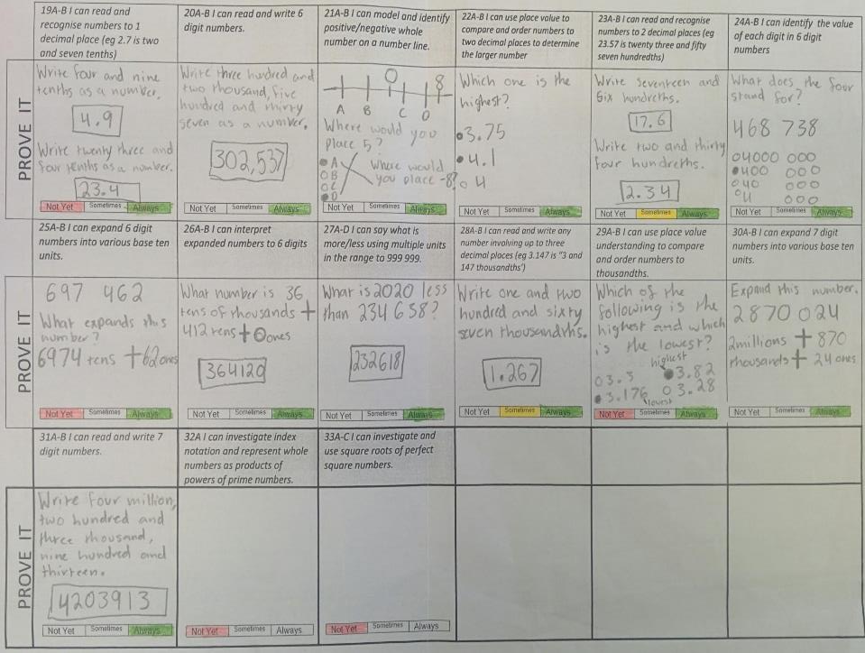

Slide 22
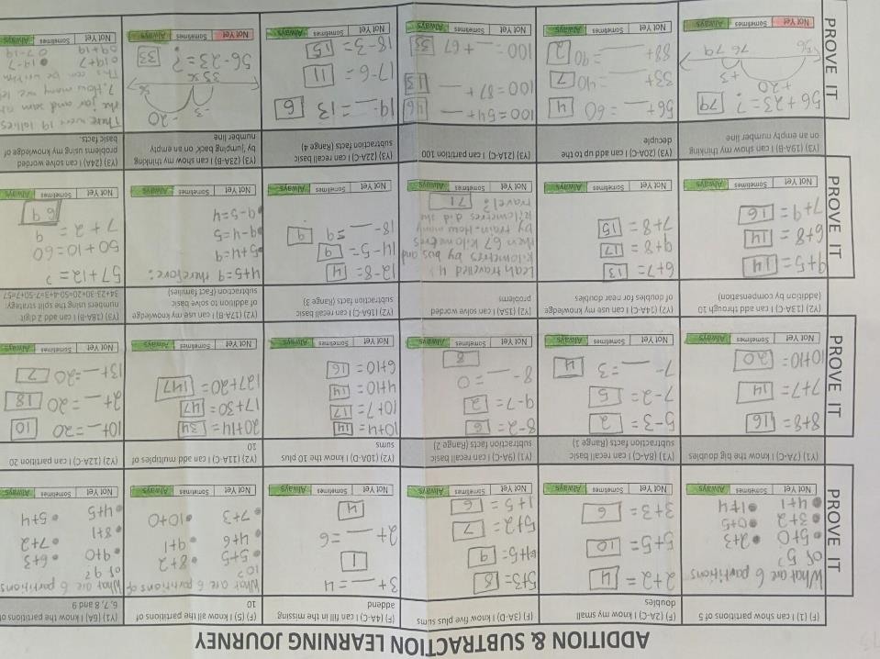

Slide 23
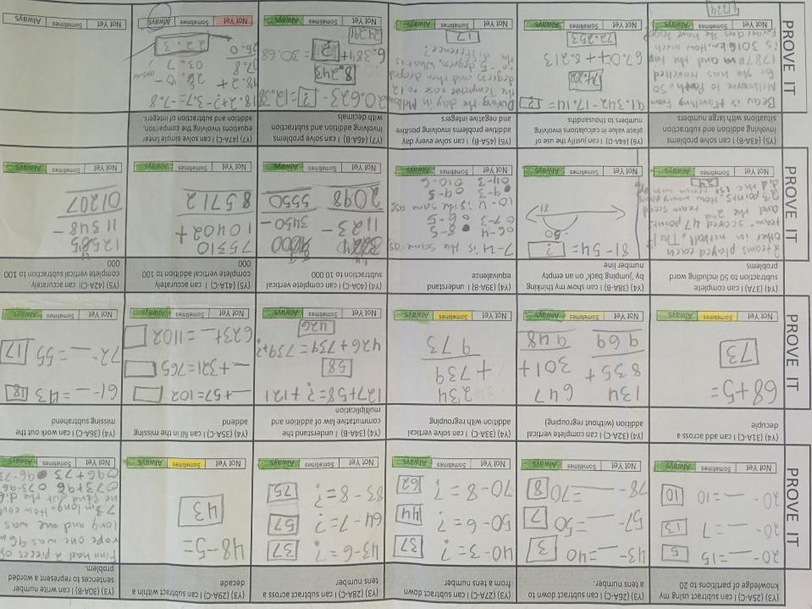

Slide 24
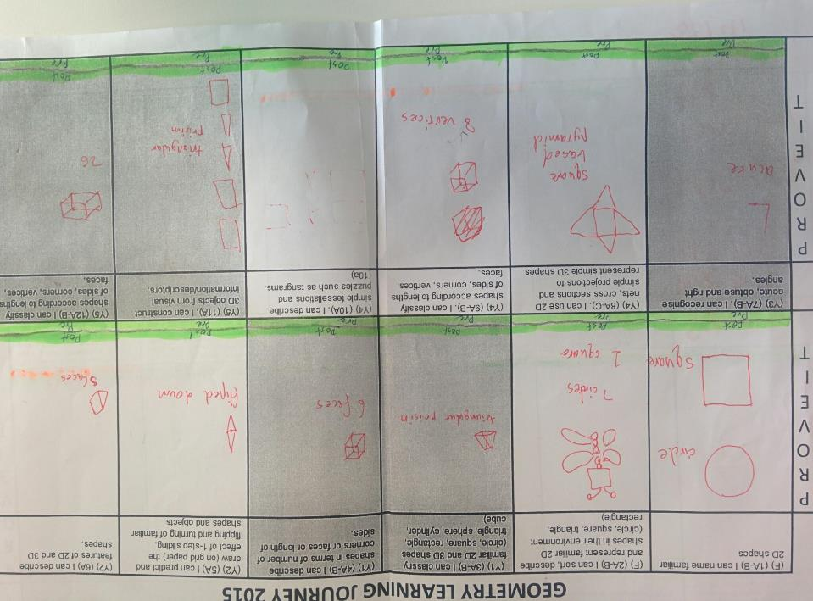

Slide 25
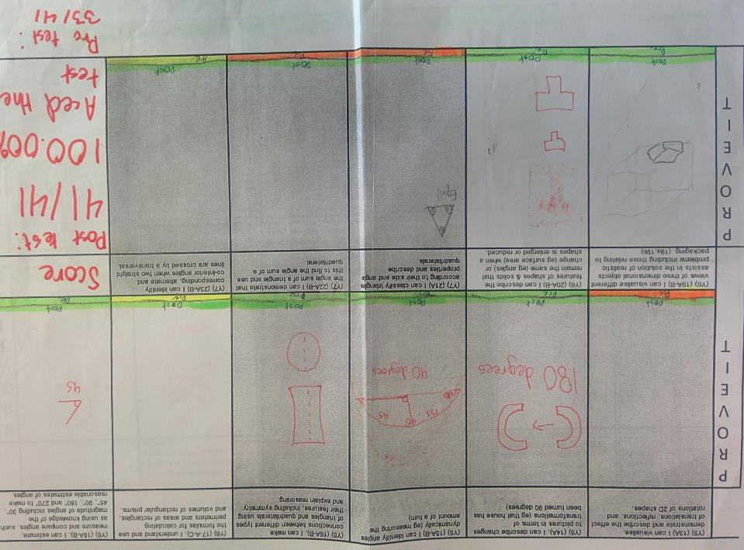

Slide 26
Direct Instruction Model
BEGINNING OF LESSON (10m) The Hook: Grab students’ attention and put them in a receptive frame of mind. Learning Intentions: Make the learning intentions and success criteria clear to students Activate / Review: Activate prior knowledge and review relevant prior learning
PRESENTATION (10m) Teacher Input: Explicitly teach the CONCEPT Teacher Input: Explicitly teach the SKILL Check for understanding: Monitor whether students ‘got it’ before preceding
GUIDED PRACTICE (30m) Development & Engagement: Develop student understanding of the concept or skill through activities and exercises. Feedback and Individual Support: Move around the room to determine the level of mastery and provide feedback as needed. and / or INDEPENDENT PRACTICE (30m) Application: Get students to apply the concept or skill in different contexts
REVIEW (5m) Bring the lesson to conclusion, review and clarify key points.
Zbar, V (2011) - ‘Ensuring a more personalised approach: A strategy for differentiated teaching in schools’, Occasional paper 121, Centre for Strategic Education, IARTV, East Melbourne.

Slide 27
Our senior maths curriculum
60%~ differentiated and explicit in applied mathematics and number
20%~ mixed ability problem solving
10%~ mixed ability number facts and drills

Slide 28
Appendix
TRAINING / HOW TO - FORMS & FLUBAROO
Google Apps training on forms
Google support on forms
Creating self-grading assessments
Using Google Forms
New Add-ons for Docs and Sheets
The new Google Sheets
OTHER IDEAS WITH FORMS
86 ways to use google forms
Google forms for everything
10 great free google forms
10 google forms for the classroom
Innovative ideas for using google forms
Uses for google forms
REFERENCES
Hattie, J. (2009). Visible learning: A synthesis of 800+ meta-analyses on achievement. Abingdon: Routledge.
Hattie, J. (2012). Visible learning for teachers: Maximizing impact on learning. Abingdon: Routledge.
Zbar, V (2011) - ‘Ensuring a more personalised approach: A strategy for differentiated teaching in schools’, Occasional paper 121, Centre for Strategic Education, IARTV, East Melbourne.

Slide 29

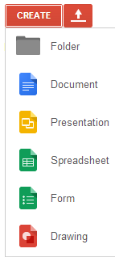
What is a Google Form?
A free service provided
by Google available
from Google Drive
Forms are created
and stored in
your Drive.

Slide 30
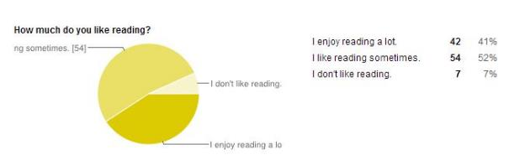
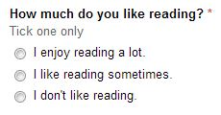
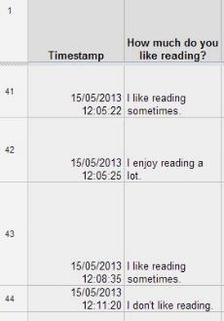
Design, send, collect, analyse, export.
Work with data and information easily, from one location

Slide 31
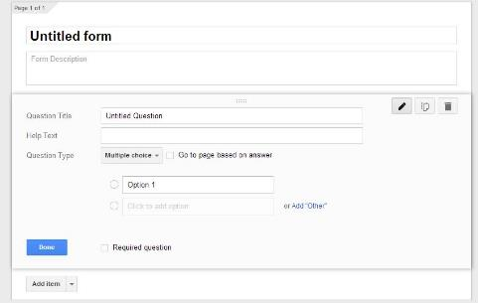
Creating a Google Form
Add a title
Design a question
Determine question type
Provide possible answers
Add as many questions as you like!

Slide 32
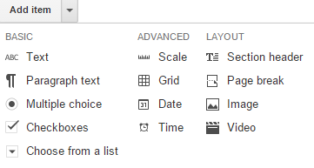
Types of items

Slide 33


Self-grading forms with Flubaroo
Mark and assess responses
Analyse data
Email scores and results
No more!
X

Slide 34
Using teacher designed online assessments
to drive differentiated instruction in mathematics
This presentation:
http://bit.ly/eppc2015
T: @anthsperanza
B: anthsperanza.global2.vic.edu.au
G: +AnthonySperanza
Anthony Speranza
St Mark’s Primary School Dingley, Victoria
ICT / T&L Leader
Debbie Darvell
St Mark’s Primary School,
Dingley, Victoria
Principal
Philip Holmes-Smith,
Director at School Research Evaluation and Measurement Services, Victoria

