Slide 1
Building Assessment Literacy with Teachers and Students:
New Challenges?
Marie Brennan
Victoria University, Melbourne
ACER EPCC Conference, Sydney May 2015

Slide 2
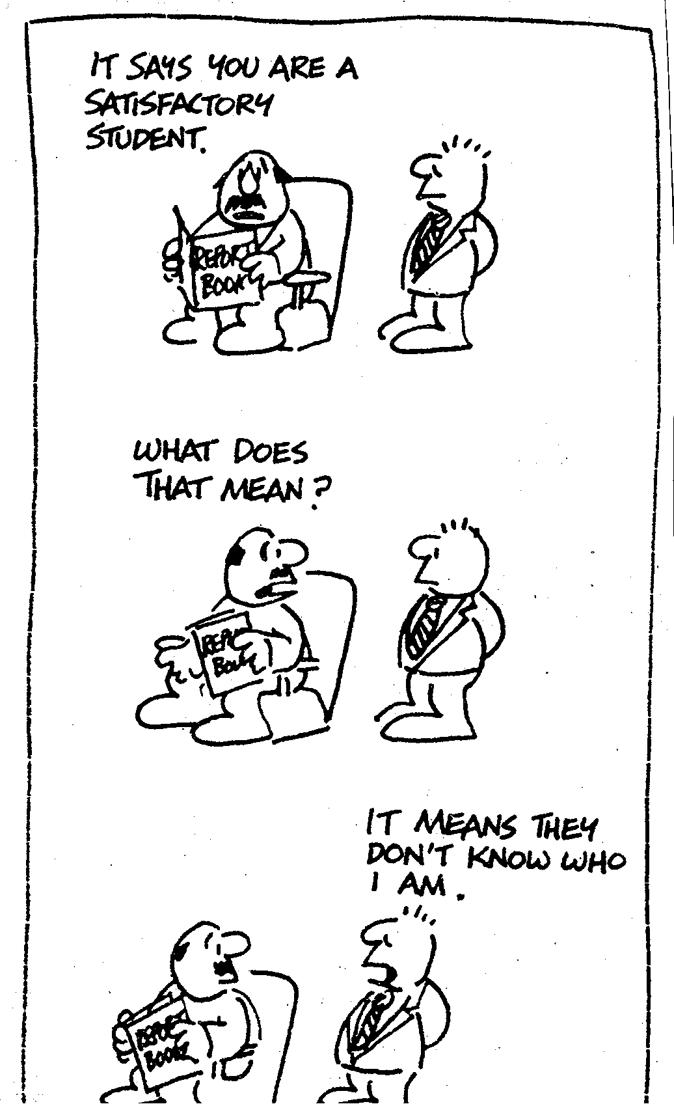
Tanberg, from Hyde & Brennan 1979: Good Work, Keep it up: Real Evaluation. Studies in Society 2 July.

Slide 3
Assessment
Assessment is an emotionally-laden term – always about values and contestation about knowledge, about the purposes of education – and often used to control teachers, schools and students
Evidence-eliciting techniques: producing data as proxy for the largely unseen: learning
Centrally re learning: by students and by teachers – and then whether schools and systems provide adequate learning environments (aka infrastructure, school culture, supports) to maximise
Knowledge – relationships – action

Slide 4
Evidence of learning used for many purposes
CLASSROOM LEVEL:
a) student reflection and metacognition (assessment as learning )
b) assessment for learning (formative; diagnostic) (student and teacher)
c) assessment of learning (summative) (Student and teacher)
ACCOUNTABILITY – FOCUS;
a) group progress
b) school effectiveness
c) system quality
d) national system
NEED FOR CLARITY RE PURPOSES IN ORDER TO DESIGN WELL, EVEN THOUGH MANY ‘INSTRUMENTS’ CAN SERVE SEVERAL PURPOSES.

Slide 5
Assessment Literacy?
Traditionally defined as skills, knowledge and understanding residing in the individual but also needs to be seen as a literacy: ‘a visible social practice with language, text and discourse’ (Gee 2003)
Klenowski (2011: 68) argues that ‘to raise the assessment literacy of teachers there is a need to understand, and practice, the fundamental principles of assessment design’, including fitness for purpose and positive contribution to learning’.
i.e. building practices that develop understandings , judgement and practices of assessment, e.g. practising assessment of, for and as learning through dialogue, performance, design and evaluation, examining and exploring effects and outcomes of activities

Slide 6
Current context for assessment
Economic uncertainty: testing argued to contribute to improving economic competitiveness
Dominant policy and media discourse is ‘rule by numbers’ - centralised
Worsening of stratification and inequality
Introduction of standards-based assessment
Strong emphasis on school-based innovation – but little infrastructure to support it.

Slide 7
Imbalances of assessment purposes?
Teachers learning to ‘read’ data, including large-scale statistical data: necessary but insufficient
Immersion in this measurement approach can skew time, valued criteria, narrow the repertoire of assessment practices in classrooms, and change school culture
Over-reliance on summative impedes attention to meeting student learning needs (Stiggins 2002)
Issue: how to balance diversity of needed range of assessment purposes and practices?

Slide 8
Imbalance among curriculum, pedagogies and assessment
Assessment is often the driver of curriculum and pedagogical change; often tied to past habits of teaching and sorting and selecting expectations.
If we focus too much on assessment, we lose sight of educational purposes and practices.
How adapt to changing world where all students stay to 17? Where content knowledge is vastly expanded? How do curriculum and pedagogies need to change? How might assessment support or even drive those changes, and develop new strategies of feedback and action?

Slide 9
Political assessment literacy?
Reading the world: Understanding not only the data of accountability-driven assessment but also the limits and dangers and possible cost-benefits.
Paying attention to which assessment purposes are being addressed and working to balance them – in classrooms, within schools and their communities, and across the system
Using educational judgement and collective activity to re-balance curriculum, pedagogies and assessment activities. Rethinking the teacher role in relation to wider assessment responsibilities (knowledge, relationships and action)

Slide 10
Social assessment literacies
Which students and groups of students are privileged and dis-privileged by which kinds of assessment?
i.e. assessment is not only an internal feedback loop: it must pay attention to the long-term, intra-community and inter-generational effects and the purposes of learning and education.
Whose knowledge, which relationships, whose domain of action would act on this?

Slide 11
Repertoires of assessment
Black & Wiliam’s (1998) among the first to demonstrate that good formative assessment increased achievement on tests; need to focus on good teaching, including the active use of assessment throughout teaching and learning activities, not just the end of units/years.
Need: teachers and students actively engaged in formative assessment thoughout, e.g. good questioning, feedback loops, observation, dialogue, self- and peer-debate, observation and monitoring, performance, portfolio construction, social/relationship and affect demonstration, among many other elements of good teaching and learning environments.

Slide 12
7 teacher competences for assessment: assessment literacy for teachers’ school level assessment activities
Connecting assessments to clear purposes
Clarifying achievement expectations
Applying proper assessment methods
Developing quality assessment exercises scoring criteria and appropriate sampling
Avoiding bias in assessment
Communicating effectively about student achievement
Using assessment as an instructional intervention
Stiggins (1999: 25-27)
NOTE: THIS ONLY FOCUSSES ON THE TEACHER: STUDENT COMPETENCES FOR ASSESSMENT NEED FURTHER ATTENTION

Slide 13
Assessment improves learning when it is used to support five key strategies in learning:
Clarifying, sharing, and understanding learning intentions and criteria for success
Engineering classroom discussions, activities, and tasks that elicit evidence of student achievement
Providing feedback that moves learning forward
Activating students as learning resources for one another
Activating students as owners of their own learning
Wiliam, D. (2011). Embedded formative assessment. Bloomington, IN: Solution Tree.

Slide 14
Huge assessment repertoire already used, invented, extended, underway ….
Observation and monitoring, both systematic and informal
Personal communication
Selecting a response e.g. multi-choice,
Constructing a response (short, long, with and without preparation)
Portfolio assessment
Performance assessment

Slide 15
An Observer’s checklist: evaluating the lesson (MACOS Evaluation Booklet p.89)
Factual questions ------Opinion questions
Short answer -----------lengthy response
Qs from teacher mostly ----mostly from students
Exchanges largely S to T --------------largely S to S
T sets & controls agenda ----Ss initiate topics
T role: Authority----------T role: non-participant
S no clear sense of purpose ----Ss clear sense of P
Less than 1/3 student p’pation ----almost all S p’p
Student interest low ------S interest high
Class is noisy --------Class is quiet

Slide 16
Student assessment literacy
Under-valued and under-documented yet central – can’t assess properly without student engagement
Self-evaluation, peer-feedback and meta-cognitive analyses of progress build language for analysis, links to other knowledge or transferability to other domains of action, reflexivity and self-monitoring, capacities to work across difference
Importance of dialogue
Assessment by Exhibition, Performance and Student-led conferences are relatively recent developments in need of local analysis and systemic infrastructure eg materials sharing/development

Slide 17
Supporting Student Assessment literacy
In classroom: opportunities for building language through dialogue, performance and reflection
In school policy
Between home/community and school
Performing learning and widening assessment participation (for, of and as learning and balance among them)
In school governance
In feedback loops to systemic agencies

Slide 18
Supporting teacher assessment literacies
Structured professional development with other teachers using real-life scenarios makes significant difference: developing shared discourse
Supporting development and embedding of formative assessment processes makes more difference to student learning than end-on or summative assessment (Wiliam 2011) but both are needed: balancing purposes
Moderation processes for development and moderation of student work samples gives opportunities for checking ‘judgement-in-context’ (Cooksey et al. 2007) : extending repertoires and judgement capacities for formative and summative activities

Slide 19
Parallel Assessment curriculum: teachers and students
High intellectual quality: critical reading of the world and education system; unpacking purposes and diverse practices of assessment
Supportive learning environments that encourage dialogue, making the tacit explicit in diverse forms, innovation and risk-taking (i.e. learning)
Use diversity as a resource for innovation, collaboration and identity-building

Slide 20
Supporting students and teachers through infrastructure and public discourse
Sample commentaries on both instruments and student work by both teachers and students readily available.
Infrastructure supporting teacher professional learning communities across and within schools (including ICT for rural and remote schools) – for moderation, for development of assessment AS teaching and learning, widening repertoires of formative (including diagnostic) assessment and balancing with summative/external assessment
More flexible external/summative assessments paying attention to diversity of background, curriculum purposes and relevance of diverse purposes of assessment
Ongoing debates about relationships among curriculum, pedagogies and assessment, including re-entry/re-teaching, addressing the persistent gaps in learning that are evident from year 3 on, to build intrinsic learning investment by all.

Slide 21
References
Connelly, S., Klenowski, V. & Wyatt-Smith, C. (2012) Moderation and consistency of teacher judgement: teachers’ views. British Educational Research Journal 38(4) 593-614. Cooksey, R., Freebody, P. & Wyatt-Smith, C. (2007) Assessment as Judgement-in-context: Analysing how teachers evaluate student writing. Educationa research and Evaluation 13 (5), 401-434.
Klenowski, V. (2011) Assessment reformand educational change in Australia. In R.Berry nad B. Adamson (Eds) Assessment Reform in Education. Education ni the Asia-Pacific Region: Issues, Concerns and Prospects 14. :63-74.
Klenowski, V. & Adie, L. (2009) Moderation as judgement practice: Reconciling system level accountability and local level practice. Curriculum Perspectives 29(1): 10-28.
Popham, J.
Stiggins, R. (2002) Assessment crisis: The absence of assessment for learning. Phi Delata Kappan 83(10) 758-65.
Wiliam, D. (2011). Embedded formative assessment. Bloomington, IN: Solution Tree.
Wiliam, D. (2011). What is assessment for learning? Studies in Educational Evaluation, 37(1), 2-14.

