Slide 1
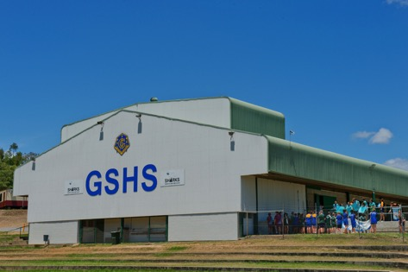
Feedback enabling students at Gladstone State High School
ACER
EPPC Conference
May 2015

Slide 2
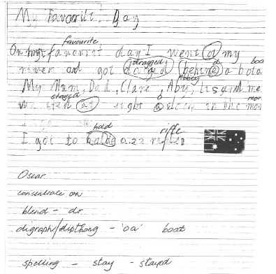

Slide 3
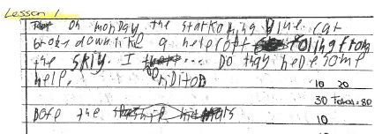

Slide 4
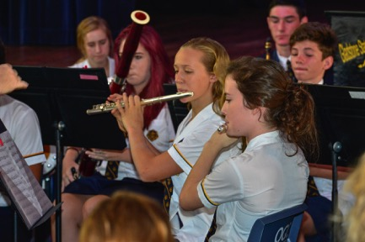
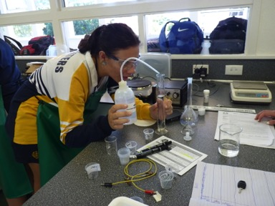
What is the moral imperative (Fullan)
Lack of representation in the U2B
Lagging results in Writing – worse than national trend
Data is not trending – it is cohort driven – lack of strategy and consistency
Even though extension classes exist, there is no triangulation in the U2B

Slide 5
Is there evidence of the following?
Lines of kids outside staffrooms waiting to see teachers to get their rough copies back
Students ‘conferencing’ in classes but talking more about what they did on the weekend than the task at hand
Students who say, “I don’t know what she means by…”
Students who say, “I have checked my rough copy, Miss.” but you can tell by the end of the first line that they haven’t
Teachers who say, “Read your work out aloud,” as if that will solve all the problems.

Slide 6
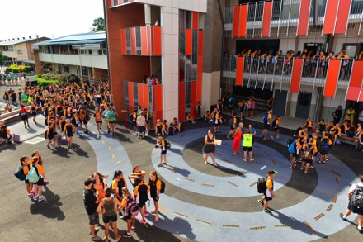



When is feedback not feedback?
When it’s editing
When it’s a one way process
When it doesn’t make sense to the child
When it doesn’t provide a way forward

Slide 7
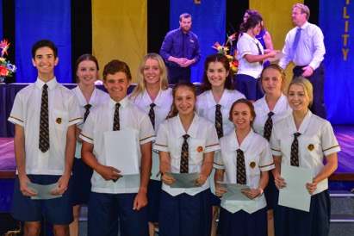
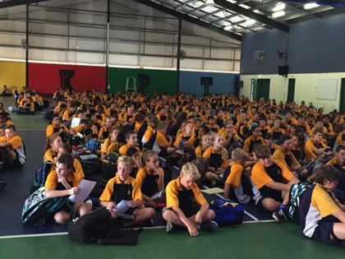
What is good feedback?
Student centred
Meaningful
Focussed on student needs
Able to be discussed in a conversation using meta language

Slide 8

What is the research telling us?
Writing is important
“Writing has an impact on our ability to learn and to think at the highest levels across disciplines. Writing literally makes students smarter.” (Shmoker, 2006, Results Now )

Slide 9
Why don’t teachers engage in writing?
Time away from content
Too difficult to assess
Too time consuming
Students can’t/ won’t write (www.collinsed.com)

Slide 10
Why don’t students engage in writing?
  Boys and underachievement, “It’s a boy heavy cohort.”
  Disengagement
  Behaviour
Fear of failure
Fear of hidden criteria
From Switch: how to change when change is hard
1.What looks like laziness is often exhaustion. (p.12)
2.What looks like resistance is often lack of clarity. (p.15)
3.Clarity dissolves resistance. (p.72)
4.Some is not a number; soon is not a time. (p.11)
www.collinsed.com

Slide 11
Write more, Grade Less
Anne Marie Hall 1994, pp 168-169
The research is strong that students are better off when we mark their work for fewer criteria…that we have just finished teaching carefully and explicitly… students need limited amounts of specific feedback and they need it quickly. Marzano and others have shown that we can be vastly more effective while spending only a fraction of the time we spend now on grading.

Slide 12
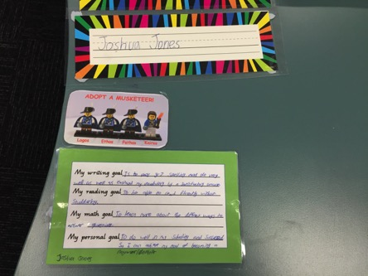
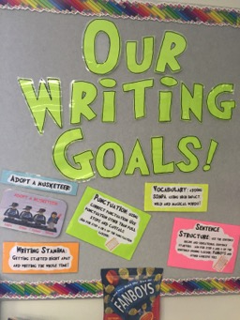
Writing at Gladstone State High School
Must have substantive content
Meets 3 “Focussed Correction Areas” which are clearly stated.

Slide 13
What are Focussed Correction Areas?
Relate to :
  Content
    Sufficient, relevant detail
    Technical vocabulary used and spelled correctly
  Organisation
    Clearly stated thesis
    Beginning and ending that establishes purpose
  Convention
    Complete sentences
    Punctuation
  Style
    Beginning that captures interest
    Powerful verbs
Collins.J 2007
The Collins Writing Program: Improving Student Performance

Slide 14
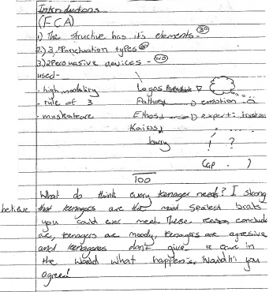
Students can apply criteria to their writing and use them to structure conferences with their peers

Slide 15
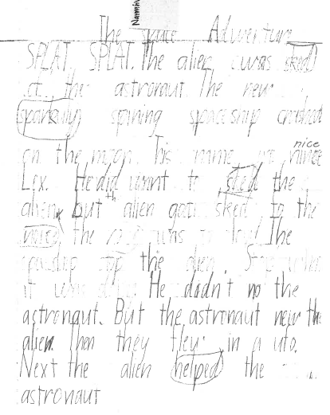
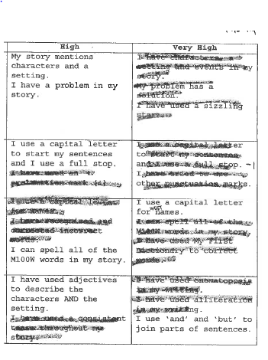

Slide 16
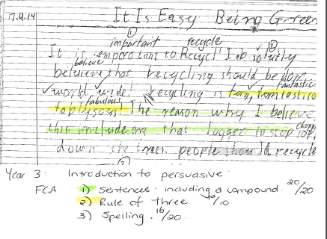
It promotes confidence, engagement, willingness

Slide 17
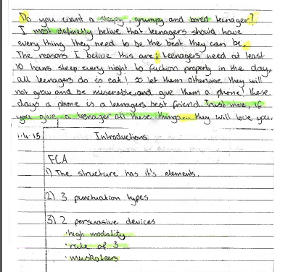

Slide 18
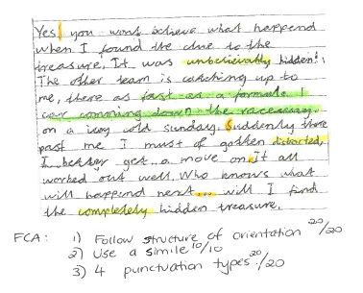

Slide 19
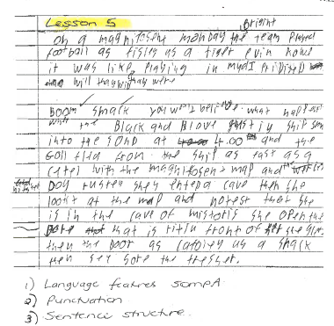

Slide 21
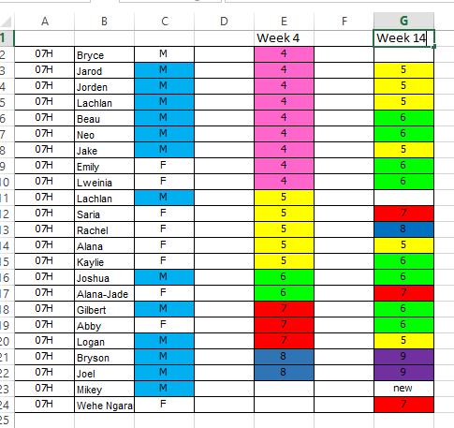

Slide 22
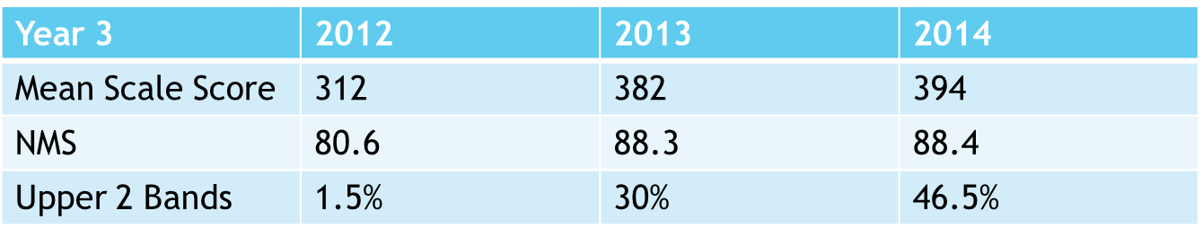
Glenmore State School
NAPLAN Writing
426 Student
107 / 25% Indigenous
72 / 17% EAL/D
14 Cultures Represented
26 / 6% Kids in Care
ICSEA: 877: 7th percentile
1st decile

