Slide 1
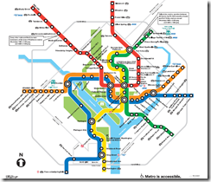
Navigating the Literacy Learning Journey …
from
Early Years
to
Year 3 and beyond
Amy Woodgate Evelyn Terry
awoodgate@somerville.qld.edu.au evelyn@sassconsult.com.au

Slide 2
The fussle grocker flebbed lapily to a roosh.

Slide 3
The fussle grocker flebbed lapily to a roosh.
What flebbed?
How did he fleb?
Where did he fleb?
What sort of grocker was he?

Slide 4
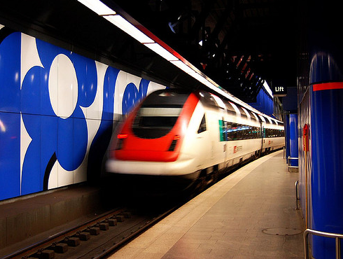
The fussle grocker flebbed lapily to a roosh.

Slide 5

Print based and language based core literacy skills
Print based core literacy skills
Phonological awareness skills
Letter sound correspondence
Letter formation
Spelling
Language based core literacy skills
Word choice .. very specific
Language structures … rules
Syntax rules
Punctuation
Coherence

Slide 6
What were we seeing?
TASK 1
Write a sentence about a picture:
The two girls are playing a great game of football.
TASK 2
Retell a story:
Jeny was so exited she got her very own shiney red bike she dident want her frends watching and laghfing so she cept her bike in her back yard she practes every arfternon then she rid to school with all her frendes.

Slide 7
Why is it not automatic?
Why does he not apply what he has learned?
OR… is the problem in the combination of the print based and language based literacy skills that are required for functional literacy tasks?
What has gone wrong on their literacy journey?
Why do the basics fall apart when he is confronted with a functional literacy task?
Are we not consolidating the spelling & punctuation enough?

Slide 8
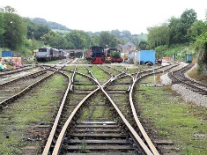
Functional Literacy
Conventions of Writing | Linguistics | Content
Letter formation Spelling Punctuation | Use of language forms Use of adjectives Use of phrases Verb tense Sentence structure | Appropriate subject matter Word choice Coherence Detail

Slide 9
OWLS - Oral and Written Language Scales
Oral instructions - age appropriate in vocabulary, sentence length, subject matter
Range of written language skills – structured, open ended
Examines the application of skills taught in classroom
Examines writer’s ability to organise ideas
Based on well defined theory of language
High correlation / consistency/reliability …

Slide 10
OWLS Assessment Results

Slide 11
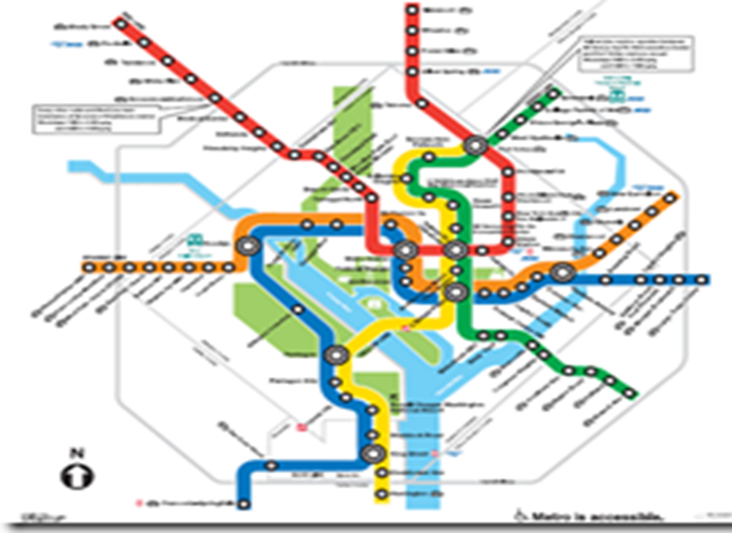
The current journey – a complex map
YEAR 3
Train delayed
PREP
All Stations… All stops
YEAR 2
Compass points shifting… is what is in our suitcase at the end of Year 2 what we need to reach the platform at Year 3?
YEAR 4
Missed the connection
YEAR 1
Express to all stations

Slide 12

Classroom practice changes
Increase student understanding of “oral vs written” language.
Explicitly teach of the language based literacy skills esp. sentence structure
Consolidate the application of the linguistic elements in functional literacy tasks
Teach language and print based literacy skills across curriculum areas

Slide 13

Some References…
Australian Curriculum www.australiancurriculum.edu.au/English/Curriculum/F-10
Carrow-Woolfolk, E. OWLS - Oral and Written Language Scales (1996) American Guidance Service, Circle Pines, MN.
Crevola, C, Hill, P. & Fullan, M. (2006). Assessment for Learning in Action. Orbit, Vol 36, No 2, 2006
Love E. & Reilly S. (2006) Words! Words! Words! In Acquiring Knowledge in Speech, Language and Hearing, Volume 8,Number 3, 2006.
Van Barneveld, C. (2008). Using Data to improve Student Achievement. What Works? Research into Practice www.edu.gov.on.ca/eng/literacynumeracy/inspire/research/whatWorks.html
Van Kraayenoord, CE, Barnett, J., Roberts, D., & Moni, K.B. (1999). Literacy assessment and student diversity; An Australian case study. International Journal of Disability, Development and Education, 46, 51-70.
Westby Carol (1985) Learning to Talk – Talking to Learn. In Simon C.S. (Ed) Communication skills and classroom success: Therapy methodologies for language learning disabled students. College Hill, San Diego, pp 182 – 213
Westwood Peter (2009) Arguing the case for a simple view of literacy assessment. Australian Journal of Learning Difficulties, Vol. 14, No. 1, May 2009, 3-15
Engaging in and Exploring Writing www.decs.sa.gov.au/literacy
OLSEL Research Report www.olsel.catholic.edu.au
www.pld_literacy.org/Language-Literacy-Link-Milestone.html

